Slide 1
CSE 340 (Chap -2) Supplementary Slides for: Function/ Procedure/ Subsection
Prepared by Fairoz Nower Khan

Slide 2
Function
Main (){
int x=0;
int y=9;
int z = addition(x,y);
.
. }
Main function is the Caller function, where a function is called, and the parameters are provided for the called function
Parameters for function can be passed using 4 Registers, that are $a0, $a1, $a2, $a3 (argument Registers)
Return address from function to origin is stored is $ra
int addition(int a, int b){
int c = a+b;
return c;
}
Value can be returned from function using 2 registers: $v0 and $v1.

Slide 3
Register Usage
$a0 – $a3: arguments (reg’s 4 – 7)
$v0, $v1: result values (reg’s 2 and 3)
$t0 – $t9: temporaries
Can be overwritten by callee
$s0 – $s7: saved
Must be saved/restored by callee
$gp: global pointer for static data (reg 28)
$sp: stack pointer (reg 29)
$fp: frame pointer (reg 30)
$ra: return address (reg 31)

Slide 4
Procedure Calling
Steps required
Place parameters in registers
Transfer control to procedure
Acquire storage for procedure
Perform procedure’s operations
Place result in register for caller
Return to place of call
§2.8 Supporting Procedures in Computer Hardware

Slide 5
Main (){
int f=0;
f = f + 1;
int z = addition(x,y);
Int c = x-y;
}
add $s0, $zero, $zero
f 🡪 $s0
addi $s0, $s0, 1
jal addition
#jumps to addition function and
#creates link with where the function is called from, by storing the address in $ra
Save the register values used by the procedure, to recover any value that can get lost
int addition(int a, int b){
int f = a+b;
return f;
}

Slide 6
Procedure Call Instructions
Procedure call: jump and link
jal ProcedureLabel
Address of following instruction put in $ra
Jumps to target address
Procedure return: jump register
jr $ra
Copies $ra to program counter
Can also be used for computed jumps
e.g., for case/switch statements

Slide 7
Leaf Procedure Example
Main (){
int f=0;
f= f + 1;
int z = leaf_example (1,2,4,3);
int y = f + z;
.
. }
jal leaf_example
Arguments:
g 🡪 $a0
h 🡪 $a1
i 🡪 $a2
j 🡪 $a3
f in $s0 (hence, need to save $s0 on stack)
Result in $v0
int leaf_example (int g, h, i, j) { int f; f = (g + h) - (i + j); return f; }

Slide 8
Saved value registers ($s0 - $s7) that are used by the function are stored in Stack, to recover any value that can get lost
8
12
16
20
24
28
Storing data in stack
$s0 register value
addi
$sp,
$sp,
$s0 register value
$sp
-4
sw
$s0,
0($sp)
$sp - 4
Stack top data
$sp
$sp + 4
Retrieving data from stack
Data
lw
$s0,
0($sp)
addi
$sp,
$sp,
4
Data
When a value is inserted in stack, the stack pointer register moves 4 slots upwards,
hence $sp = $sp - 4

Slide 9
Arguments:
g 🡪 $a0, h 🡪 $a1, i 🡪 $a2, j 🡪 $a3
f in $s0 (hence, need to save $s0 on stack)
Result in $v0
jal leaf_example
MIPS Code:
leaf_example:
addi
$sp,
$sp,
-4
C Code:
sw
$s0,
0($sp)
int leaf_example (int g, h, i, j) { int f; f = (g + h) - (i + j); return f; }
add
$t0,
$a0,
$a1
add
$t1,
$a2,
$a3
sub
$s0,
$t0,
$t1
add
$v0,
$s0,
$zero
lw
$s0,
0($sp)
addi
$sp,
$sp,
4
jr
$ra

Slide 10
Leaf Procedure Example
Main (){
int f, x=0;
f= f + 1;
int z = leaf_example (1,2,4,3);
int y = f + z + x;
.
. }
jal leaf_example
Arguments:
g 🡪 $a0
h 🡪 $a1
i 🡪 $a2
j 🡪 $a3
f in $s0, x in $s1 (hence, need to save $s0, $s1 on stack)
Result in $v0
int leaf_example (int g, h, i, j) { int f, x; f = (g + h) - (i + j);
x= f+1; return f; }

Slide 11
Saved value registers ($s0 - $s7) are stored in Stack used by the function, to recover any value that can get lost
4
8
12
16
20
24
$s1 register value
$sp
Storing data in stack
$s0 register value
addi
$sp,
$sp,
-4
$s0 register value
$sp
$sp - 4
sw
$s0,
0($sp)
$s1 register value
Stack top data
$sp
addi
$sp,
$sp,
-4
sw
$s1,
0($sp)
Data
Data
Retreving data from stack
Last In First Out
When a value is inserted in stack, the stack pointer register moves 4 slots upwards, hence $sp = $sp - 4
lw
$s1,
0($sp)
addi
$sp,
$sp,
4
lw
$s0,
0($sp)
addi
$sp,
$sp,
4

Slide 12
MIPS Code:
Arguments:
g 🡪 $a0, h 🡪 $a1, i 🡪 $a2, j 🡪 $a3
f in $s0, x in $s1 (hence, need to save $s0, $s1 on stack)
Result in $v0
leaf_example:
addi
$sp,
$sp,
-4
sw
$s0,
0($sp)
addi
$sp,
$sp,
-4
sw
$s1,
0($sp)
C Code:
add
$t0,
$a0,
$a1
add
$t1,
$a2,
$a3
int leaf_example (int g, h, i, j) { int f, x; f = (g + h) - (i + j);
x= f+1; return x; }
sub
$s0,
$t0,
$t1
addi
$s1,
$s0,
1
add
$v0,
$s1,
$zero
lw
$s1,
0($sp)
addi
$sp,
$sp,
4
lw
$s0,
0($sp)
addi
$sp,
$sp,
4
jr
$ra

Slide 13
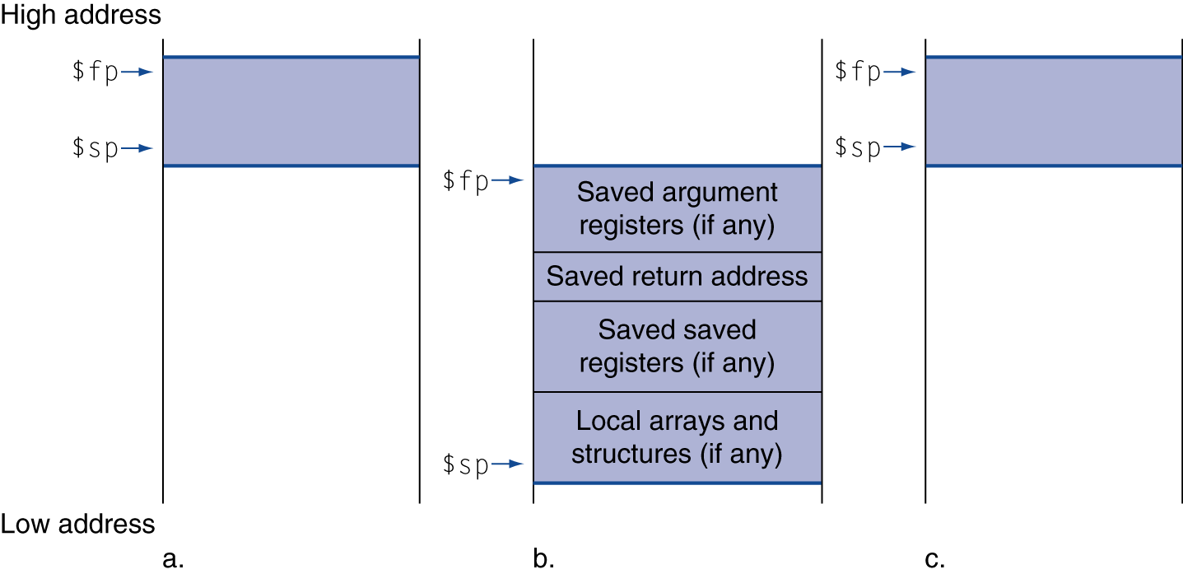
Local Data on the Stack
Local data allocated by callee
e.g., C automatic variables
Procedure frame (activation record)
Used by some compilers to manage stack storage

